Slide 1


Programming for AI
An Epoch-GDSC Collaboration

Slide 2
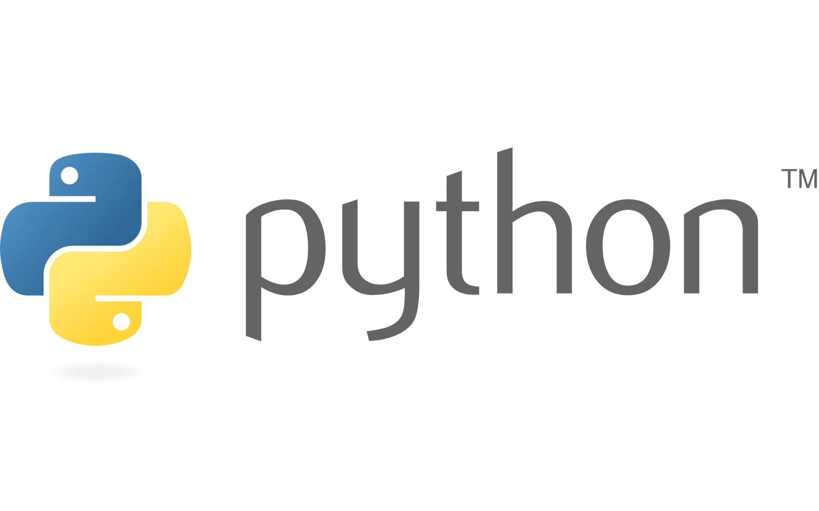
Revisited!
This time a bit faster :)

Slide 3
Python Basics - Revisited!
Data Types:
Strings
Lists
Dictionary
Tuples
Sets
Membership : The in and not in operator
Functions
Lambda Expressions

Slide 4
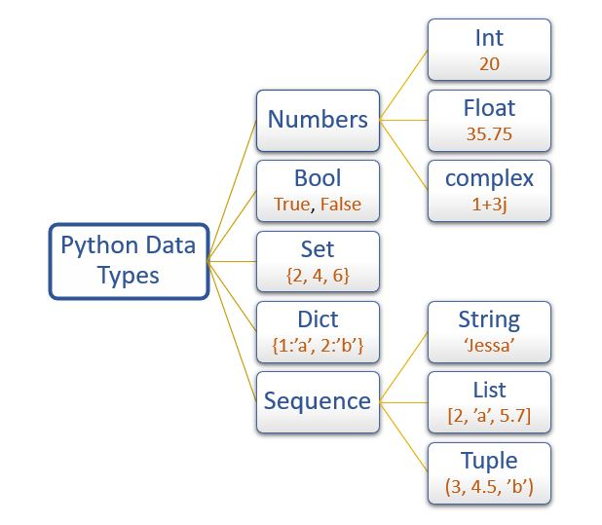
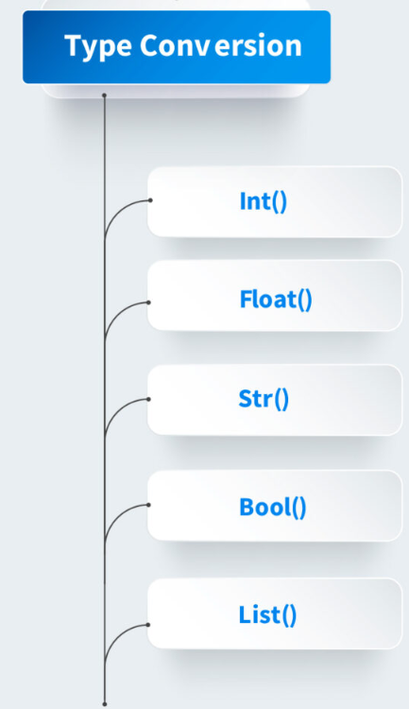
Variables and Datatypes
Python has no command for declaring a variable.
A variable is created the moment you first assign a value to it.

Slide 5
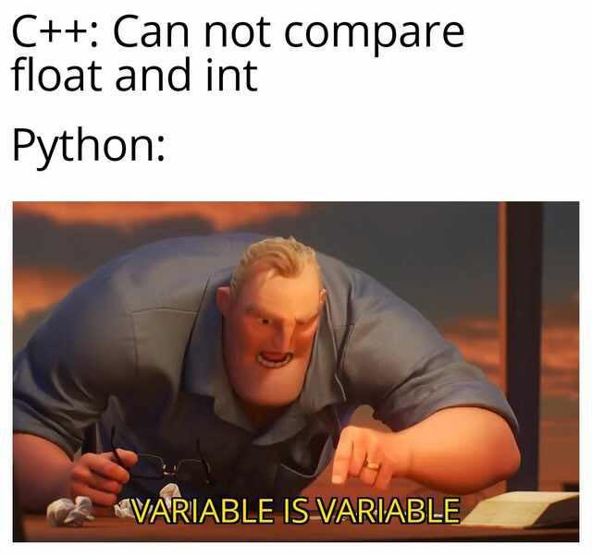
Python Vs C/C++? Well, who is better?

Slide 6
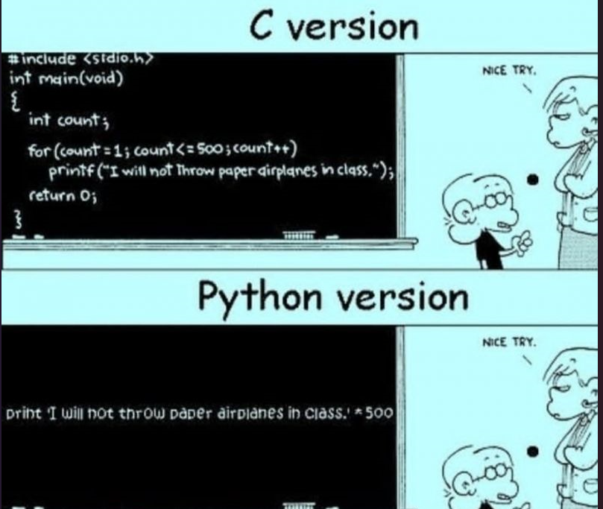
Python wins??? Wait, not yet!

Slide 7
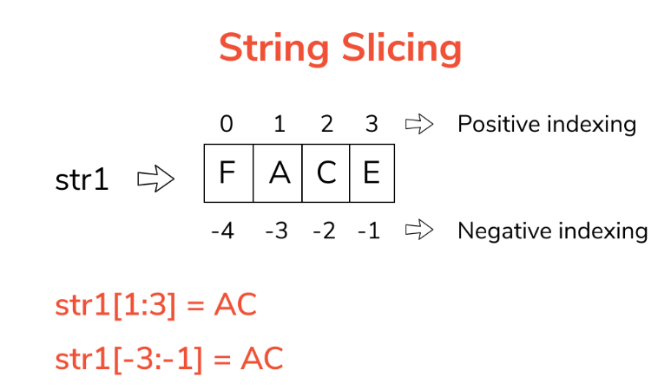
No strings attached!
Strings in python are surrounded by either single quotation marks, or double quotation marks.
Slicing: Return a range of characters by using the slice syntax.

Slide 8
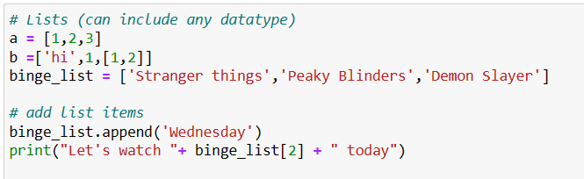
Lists = Arrays?
Lists are used to store multiple items in a single variable. Can include any datatype
Lists are created using square brackets:
Can you predict the output ?

Slide 9
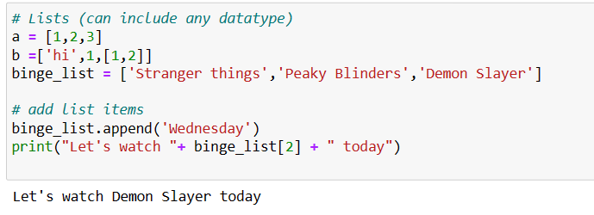
Ready for Binge Watching?
The output :-

Slide 10
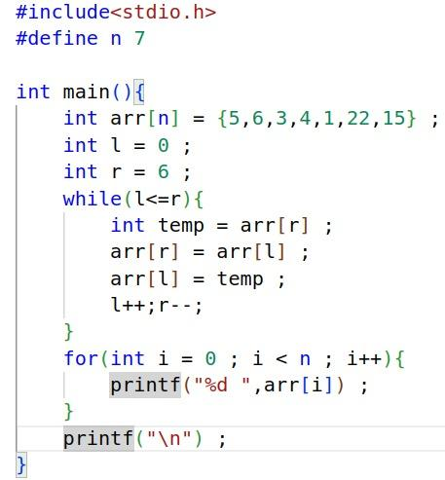
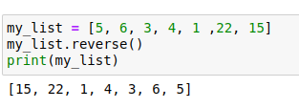
Lists in Python vs Arrays in C
Code for reversing an array
Lot of inbuilt methods in Python
Easy and concise compared to C

Slide 11
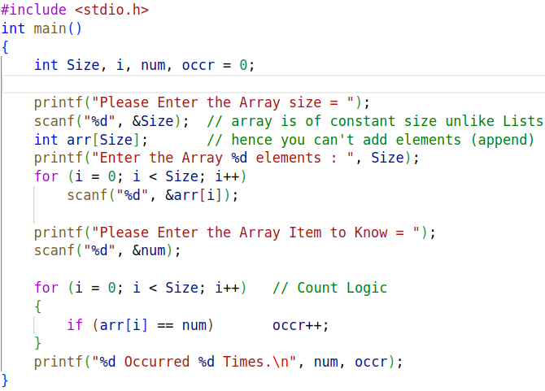
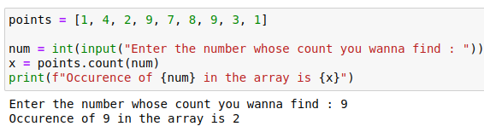
Python wins??? Wait, not yet! - Now, yes - Maybe?
A simple task for counting the number of of occurrence of a particular element in an array is so much longer in C than in Python !
Look it for yourself !

Slide 12
Inbuilt Functions in Lists
Due to the popularity of lists, it has a lot of in-built methods (which you can explore ) listed as
append() Adds an element at the end of the list
copy() Returns a copy of the list
count() Returns the number of elements with the specified value
index() Returns the index of the first element with the specified value
insert() Adds an element at the specified position
pop() Removes the element at the specified position
remove() Removes the item with the specified value
reverse() Reverses the order of the list
sort() Sorts the list

Slide 13
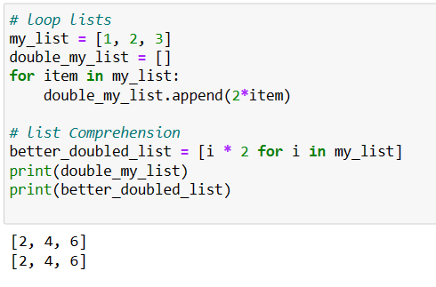
List Comprehension
Use list comprehension when you want to create a new list based on the values of an existing list.
It offers shorter syntax compared to using for loops to create a new list

Slide 14
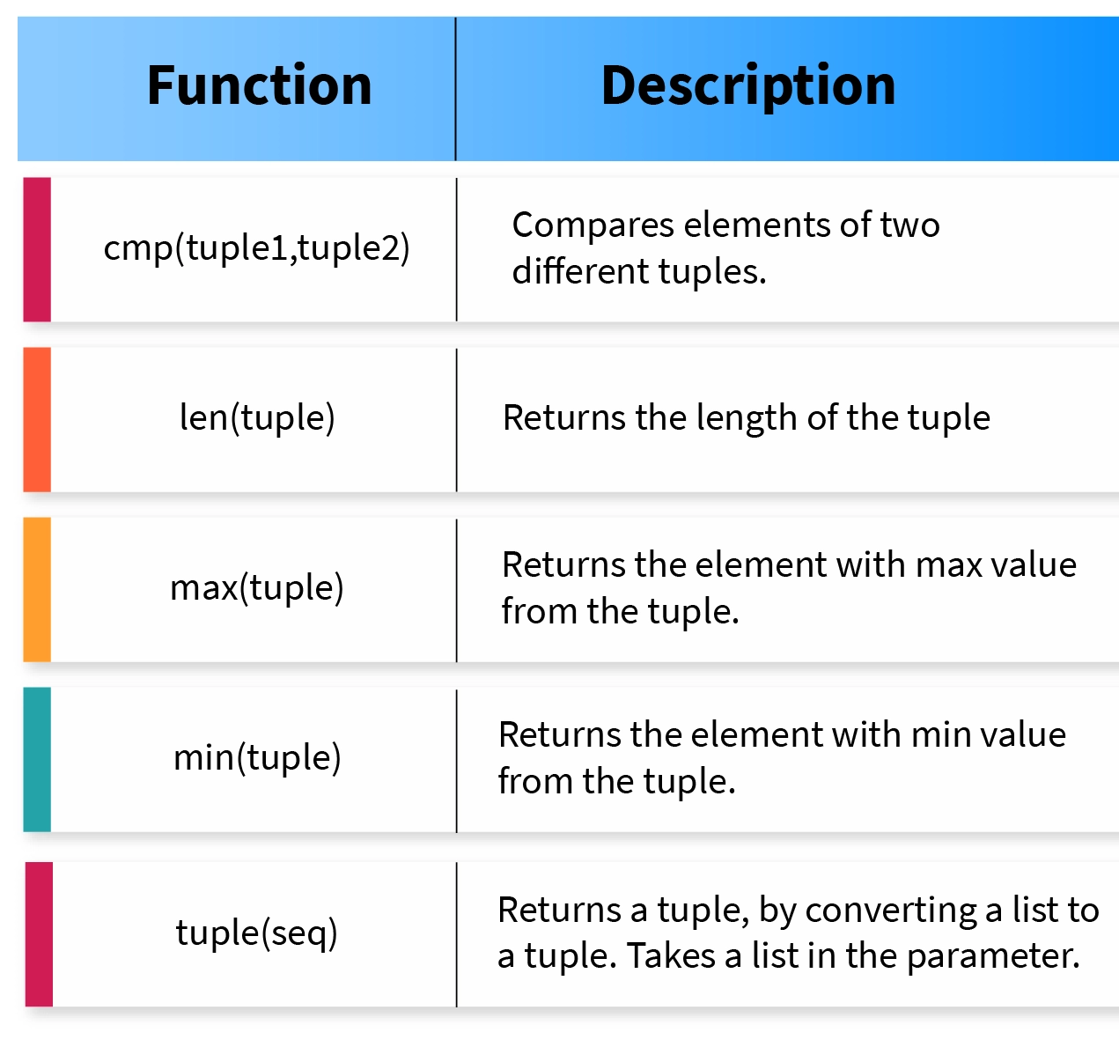
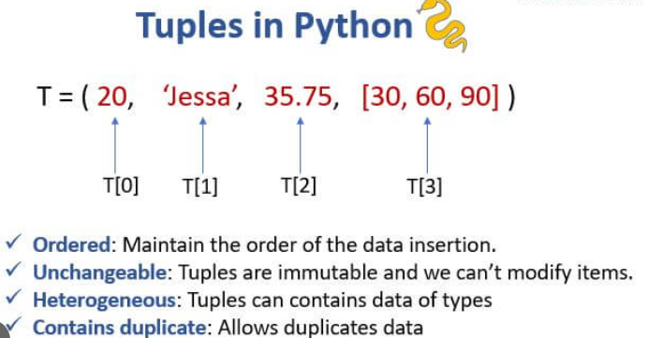
Tuples
A tuple is a collection which is ordered and immutable(unchangeable)
Tuples are fixed size in nature whereas lists are dynamic. In other words, a tuple is immutable whereas a list is mutable.

Slide 15
More on Tuples
You can't add elements to a tuple. Tuples have no append method.
You can't remove elements from a tuple.
You can find elements in a tuple, since this doesn’t change the tuple.
Why tuples when there is lists ? Or when to use tuples?
Faster than lists. If you're defining a constant set of values and all you would do with it is iterate through it, use a tuple instead of a list.
Makes your code safer if you “write-protect” data that does not need to be changed. Using a tuple is like having an implied assert statement that this data is constant.
Tuples are like Jee Advanced Ranks, you can't change them !

Slide 16
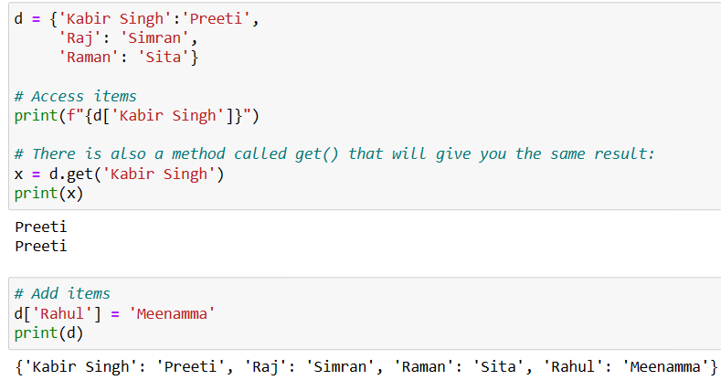
Dictionaries - Not the Oxford one!
used to store data values in {key:value} pairs.
is ordered , changeable and do not allow duplicates in the sense that you can not repeat keys.

Slide 17
Dictionaries >> Two Lists
You can also access items of a dictionary using its key name e.g d[‘Raj’]
Dictionaries can have any data type in the value
Each key must be immutable. Values maybe mutable.
This allows lists to be the values of a key. Lists cannot be keys.
Why not two lists but a dict?
Easier and faster because it uses key - value mapping format, something 2 lists being used parallely can’t.

Slide 18
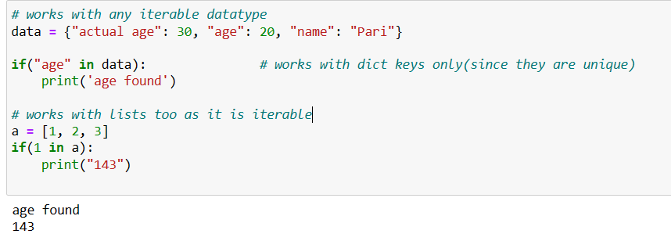
The ‘in’ and "not in" Operator in Python
The in keyword can also be used to check if a value is present in a sequence (list, range, string etc.).

Slide 19
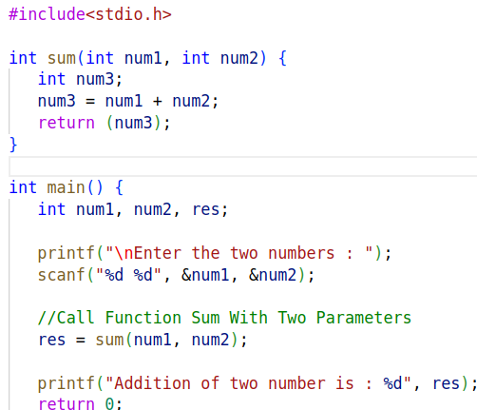
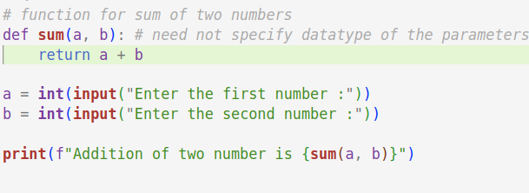
Functions in Python vs C
A simple code for adding 2 numbers
Lots of line in C
Simplified in Python

Slide 20
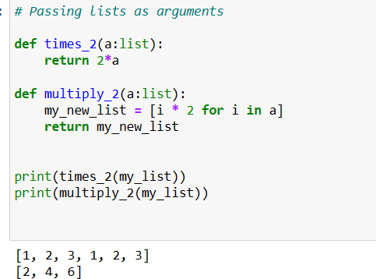
Lists as argument to function!
-
Note that multiplying a list with a number k will repeat the items of the list as the size of the number k

Slide 21
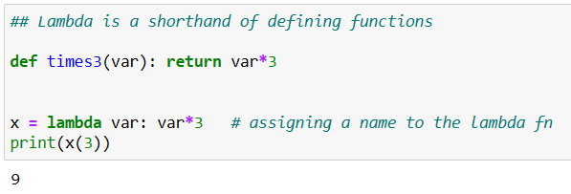
λ - expressions!
Syntax: lambda arguments : expression

Slide 22

Intro to

Slide 23
Numpy Vs Lists
What is numpy?
NumPy is a Python library used for working with arrays.
Various functions of linear algebra, fourier transform, and matrices make numpy arrays a powerful tool.
Example: my_numpy_array = [1,2,3]
What is a list?
A Python list is a collection that is ordered and changeable.
Example: Var = ["Epoch", "IIT", "Hyderabad"]

Slide 24
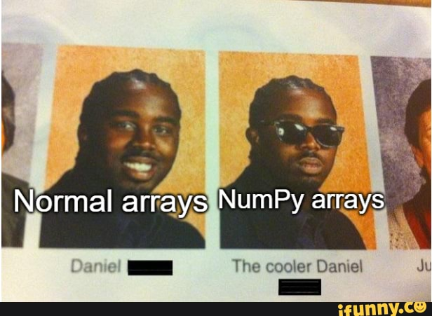
NumPy Arrays vs Normal Arrays - Is comparison even needed?

Slide 25
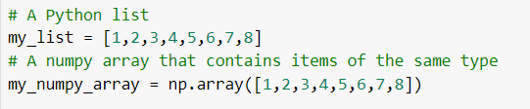
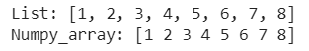
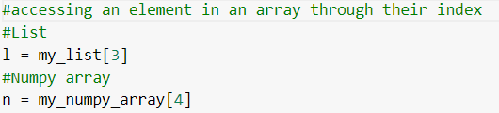
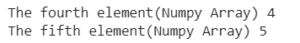
NumPy Operations = Superset of List Operations
Initialization:
Accessing the items through index:

Slide 26
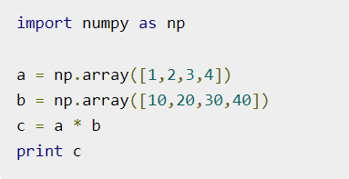
Broadcasting
The term broadcasting refers to the ability of NumPy to treat arrays of different shapes during arithmetic operations.
Arithmetic operations on arrays are usually done on corresponding elements. If two arrays are of exactly the same shape, then these operations are smoothly performed.

Slide 27
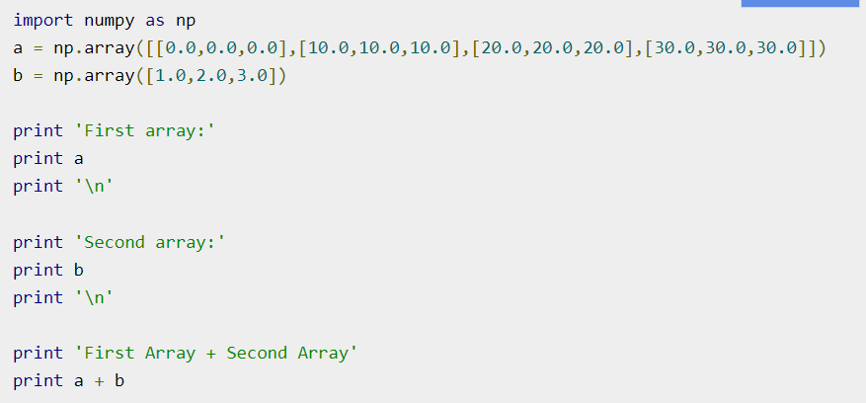
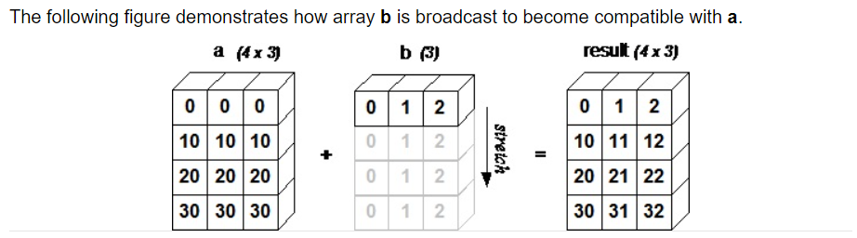
Example

Slide 28
Slicing and Dicing
To slice means to cut and to dice means to cut into very small uniform sections and the two actions are often performed sequentially.
For example, a chef may first cut an onion into slices and then cut the slices up into dices.
In data analysis, the term generally implies a systematic reduction of a body of data into smaller parts or views that will yield more information.
The term is also used to mean the presentation of information in a variety of different and useful ways.

Slide 29
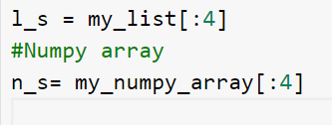
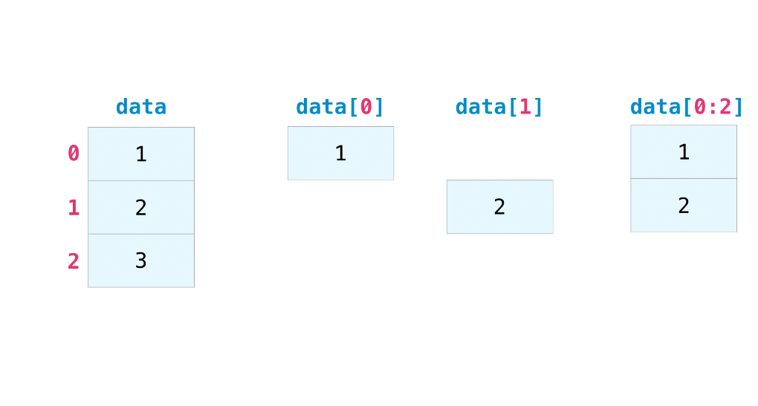
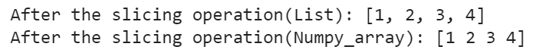
Slicing again…you ready now?

Slide 30
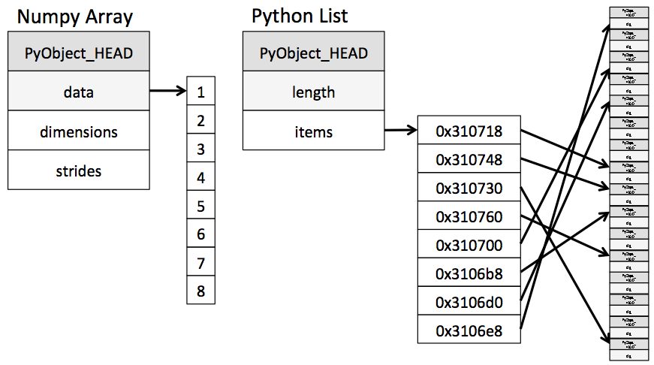
NumPy Arrays vs Lists: How are they represented internally?

Slide 31
NumPy Arrays are faster and memory efficient - Explained!
NumPy arrays, unlike lists, are kept in a single continuous location in memory, allowing programs to access and manipulate them quickly. Having them in contiguous memory locations helps reduce latencies in finding the next element and traversal is made faster this way!
Lists are internally implemented using the Linked List Data Structure. In order to store the pointers for addresses of the previous and next elements in the list, some extra memory is taken. In NumPy, since they are allocated memory continuously, there is no need to have their pointers to point us to the address of the next locations.

Slide 32
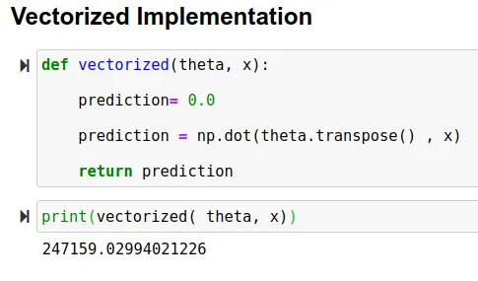
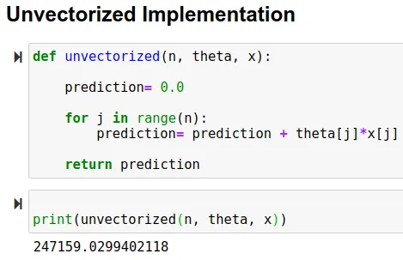
The Vectorization Hack!
Vectorization is the process of converting an algorithm from operating on a single value at a time to operating on a set of values at one time.
Advantages of Vectorized Implementation
Our code runs efficiently
Our code becomes simpler and easy to debug

Slide 33


Slide 34
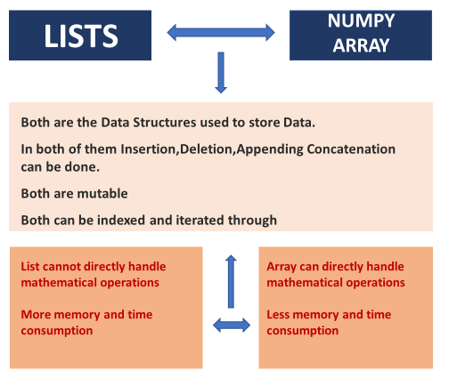
And that’s a wrap - Lists vs NumPy Arrays!

Slide 35

Random Number Generation

Slide 36
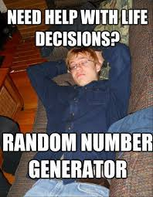

Slide 37
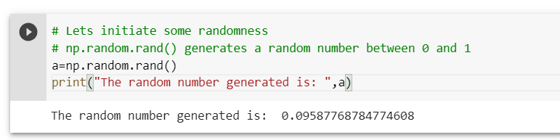
Random Numbers
Python defines a set of functions that are used to generate or manipulate random numbers through the random module.
np.random rand(shape)
It produce random values in a given shape from a uniform distribution.

Slide 38
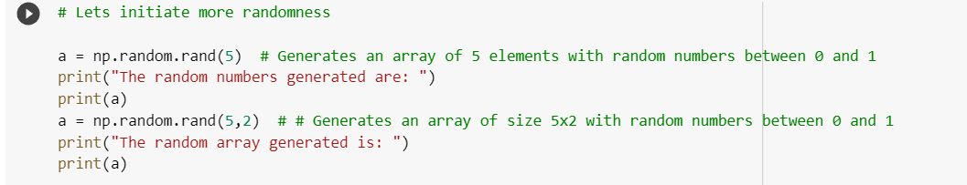
Random Arrays and Matrices
Let’s create NumPy array with random numbers

Slide 39
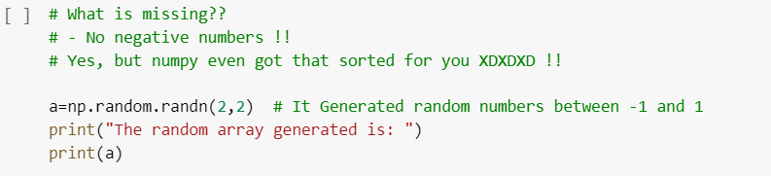
Can we generate negative random numbers too? Yes!
What if we want random negative numbers too?
np.random.randn(shape)
Returns random numbers sample from a “standard normal” distribution.

Slide 40
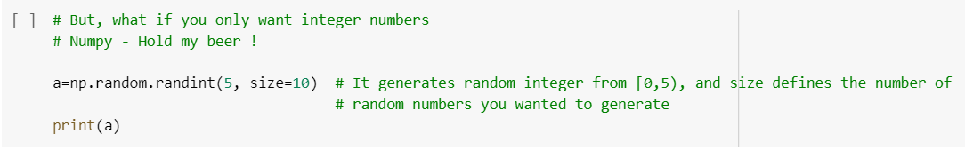
Random Integers
All the above method generates random floating point numbers, but what if you want random integers.
np.random.randint(low, high=None, size=None, dtype=int)
Low = 0 (default)

Slide 41
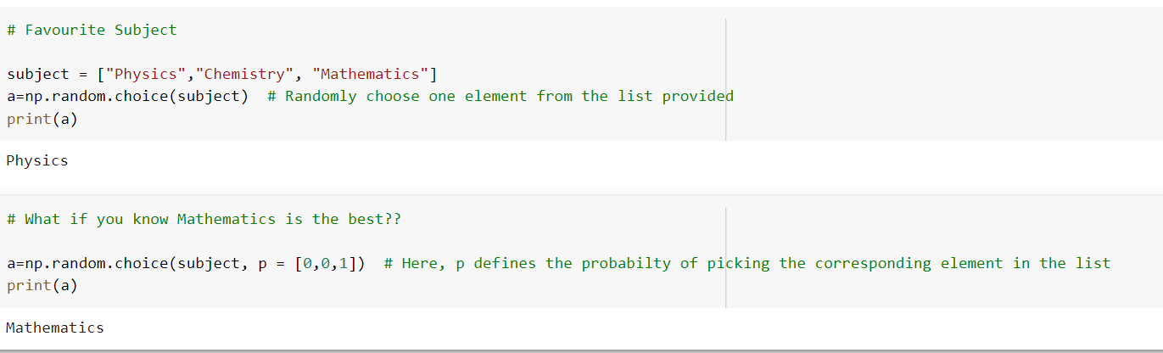
np.random.choice
np.random.choice(a, size=None, replace=True, p=None)
The parameter p defines the probabilities associated with each entry in a. If not given, the sample assumes a uniform distribution over all entries in a.

Slide 42
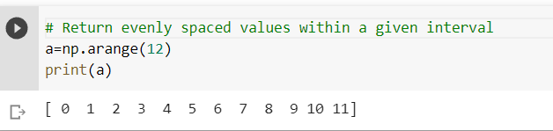
np.arange
Let’s generate some organized numbers now
np.arange(start, stop, step):
allows you to define the step size and infers the number of steps(the number of values you get)

Slide 43
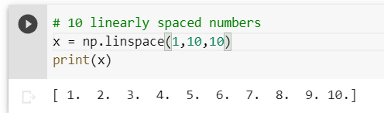
np.linspace
np.linspace(start, stop, num)
It allows you to define how many values you get including the specified min and max value
How it is different from np.arange()?
You do not need to specify the step size in np.linspace. It calculates the step size according to the number of points you want.

Slide 44
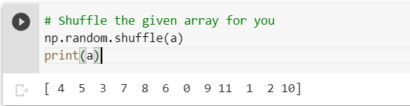
np.shuffle: Nah, not the Dance Club :-|
np.shuffle(x)
Modify a sequence in-place by shuffling its contents.
From shuffling our spotify playlist to shuffling our arrays, we have came a long way.

Slide 45
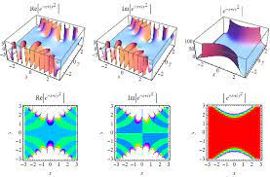
Probability Distributions

Slide 46
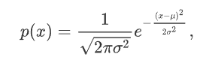
Probability Distributions: Gaussian Distribution
Gaussian/Normal distribution
- The probability density for the Gaussian distribution is
Saw this in Modern Physics right? It’s not that scary as it looks!
The function has its peak at the mean, and its “spread” increases with the standard deviation. This implies that normal is more likely to return samples lying close to the mean, rather than those far away.

Slide 47
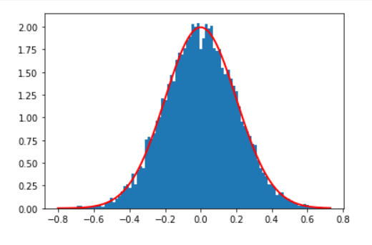
Gaussian Distribution - The Bell Curve!

Slide 48
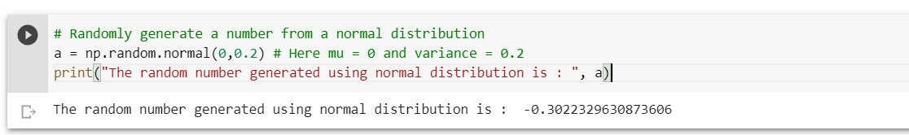
Random Sampling from Distributions
np.random.normal(loc = 0.0, scale = 1.0, size = None)
It generates random numbers from a normal distribution.
Here, loc is the mean of the distribution and scale = variance of the distribution.

Slide 49
Other Distributions!
There are still a lot of distributions that NumPy offers like:
np.random.weibull()
np.random.poisson()
np.random.binomial()
np.random.uniform()
etc.,
These are left for you to explore ! And stay tuned for the Math for ML Workshop!

Slide 50
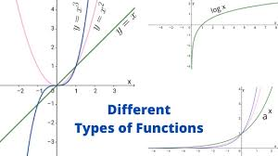

Functions and Gradients

Slide 51

Mathematical Functions - Wait, we gonna see Cal - 1? Absolutely not!
Mathematical functions in numpy are special because they can be used to perform operations element-wise on either python lists or numpy arrays.

Slide 52




Trig Functions!
.sin(), .cos(), .tan()
.arcsin(), .arccos(), .arctan()

Slide 53



Trigonometric functions
.sinh(), .cosh(), .tanh()
.degree(), .radian()

Slide 54


Logarithmic functions
.log(), .log2(), .log10()
.exp(), .exp2()

Slide 55


Additional functions
.around(), .floor(), .ceil()
.mod(a,b)
Modulo function, prints remainder of elements in a with those in b element wise.

Slide 56


.max(), .min()
The maximum/minimum element in an array.
.add(), .subtract(), .multiply(), .divide()
Add, subtract, multiply, or divide two numpy arrays element wise.

Slide 57


.conj(), .isreal()
.maximum(), .minimum()

Slide 58


A few interesting functions
.cbrt()
- returns the cube root of a number.
It is one of the few ways in python that allows you to take the real cube root of a negative number - Most functions return the complex root instead.

Slide 59

.where()
Allows you to set your own conditions and returns result from the first array if true, else returns the value from the second array.

Slide 60


Gradients
np.gradient(fx,x)
This will output the approximate gradient calculated using numpy arrays of f(x) and x.

Slide 61


Since gradients are calculated mathematically, they do have inaccuracies - but thankfully, they are rather low.

Slide 62


Matrix Operations and Transformations

Slide 63

Matrices or Multi-Dimensional Arrays
Let's cover some basic functions to create numpy matrices
Matrices from 2D or 3D or ND Lists.
Ones, Zeros,and Identity.

Slide 64

Creating Matrices using NumPy array method
array() Method:
It takes a 2D or 3D or ND List and returns a Numpy Multidimensional Array or Matrix.

Slide 65



Creating Matrices using NumPy Functions
zeros():
Returns a Numpy Array of all zeros of given shape.
ones():
Returns a Numpy Array of all ones of given shape.
identity():
Returns a 2D Identity Square Matrix of given Rows, Columns.

Slide 66




Shape of np array
shape:
Returns the number of elements in each dimension of the np array.
ndim:
Returns the Number of Dimensions of the np array.

Slide 67

Reshaping np arrays
reshape():
Returns the reshaped np array if possible.

Slide 68

Matrix Transformations : Addition
Now we will look at a function to add two matrices:
add() method : Takes Two numpy matrices of same size and adds them.

Slide 69


C vs NumPy for matrix multiplication

Slide 70

Matrix Transformations : Multiplication
Now we will look at a function to multiply two matrices:
element wise matrix multiplication : Multiplies matrices element by element just as add() does

Slide 71

Matrix Multiplication - 1
matmul() method : Multiplies matrices just like you did in your JEE !

Slide 72


Matrix Multiplication - 2
Another way of multiplying matrices: @ operator

Slide 73

Matrix Transformations : Trace
trace() method takes np array as input and outputs its trace.

Slide 74

Matrix Transformations : Determinant
linalg.det() method takes np array as input and returns its determinant

Slide 75


Matrix Transformations : Transpose
T attribute returns a matrix which is the transpose of the given Matrix.

Slide 76

Matrix Transformations : Inverse
linalg.inv() method takes matrix as input and return a matrix which is its inverse

Slide 77

Matrix Transformation : Matrix Power
linalg.matrix_power() takes a matrix and an integer as input and returns matrix raised to the power integer.

Slide 78

Solving Linear Equation
Quick Exercise!
Given matrices A and B, can you calculate X such that AX = B using functions used so far ?

Slide 79

Solving A linear equation
Solving a linear equation can be cumbersome when the number of equations increases, numpy gets it done efficiently!

Slide 80


Matrix Transformations : Stacking
Stacking matrices in a new dimension has many uses. This can be implemented with the numpy stack() method

Slide 81
Other Functions
There are still a lot functionalities that NumPy offers like:
Important Statistical Functions:
mean(), median(), var()[For variance] ,std() [Standard Deviation]
Functions for expanding and squeezing dimensions:
squeeze(), expand_dims()
These are left for you to explore !!!

Slide 82

Everything about

Slide 83


Slide 84

What is Pandas?
Pandas is a Powerful, Flexible, Fast and easy to use open source library which consists of Data Analysis and Manipulation Tools built on top of Python.
It is used for working with Data sets and has many functions for exploring, cleaning, analyzing and manipulating data.
Its name has references to “Real Life Panda”, “Python Data Analysis” and “Panel Data” and was created in 2008.

Slide 85

What are Pandas Series?
Pandas Series is a One Dimensional Array which can store data of different types like integers, floats, strings, python objects etc.
It supports both integer-based and label-based indexing through which we access the elements.

Slide 86


Creating Pandas Series from np arrays, dictionaries
With the index argument, we can name our own labels.
Series Labels are the keys and the elements are values of the Dictionary.

Slide 87

Accessing Elements of the Pandas Series
We can access the Elements using the integral-index or label of the element and the [] operator.
There are other ways also to access the elements of the Series which we will discuss later.

Slide 88


Accessing Elements of the Pandas Series
Accessing the Element of Pandas Series using its Label
Slicing the Pandas Series

Slide 89

What are Dataframes?
Pandas Dataframe is a like 2D array or can be thought of as a table with rows and columns.
In a Dataframe we can store various types of data ranging from integers, strings to datetime objects etc.
Dataframe Table contains Series as its columns.
We can perform Arithmetic operations, modifying the rows and columns of Dataframe etc.

Slide 90


Creating Dataframe from Series
Creating a Pandas Series ser2 from roll_marks Dictionary
Creating a Pandas Series ser1 from roll_name Dictionary

Slide 91

Creating Dataframe from Series
Merging Series 1 and Series 2 into a DataFrame df

Slide 92



Accessing Elements of Dataframe
loc():
loc() gets rows (and columns) with particular labels.
iloc():
iloc() gets rows (and columns) with integer locations

Slide 93




Attributes of DataFrame
df.shape
Returns the dimensions of the Dataframe.
df.index
Returns the Index of the Dataframe.
df.dtypes
Returns the Data types of each column of the Dataframe.
df.columns
Returns the Column Labels of the Dataframe.

Slide 94


Attributes of DataFrame - Contd
df.values
Returns the Dataframe in the form of numpy array.
df.info
Returns the summary of the Dataframe.

Slide 95

Reading a Dataframe from CSV File or Excel File
pd.read_csv(fileName)
Reads a CSV File into a Dataframe.

Slide 96


Slide 97

Reading a Dataframe from CSV File or Excel File
pd.read_excel(fileName)
Reads an Excel File into a Dataframe.

Slide 98


Slide 99


Writing a Dataframe into a CSV File or Excel File
df.to_csv(fileName)
Writes the DataFrame into a CSV File with name as fileName.
df.to_excel(fileName)
Writes the DataFrame into an Excel File with name as fileName.

Slide 100


Viewing the Data Frame
df.head(n)
Returns the First n rows of the Dataframe.
df.tail(n)
Returns the Last n rows of the Dataframe.

Slide 101

Accessing Rows of a Data Frame
df.loc()
We can access using the Labels of the Rows or also using a Boolean array.

Slide 102

Accessing Rows of a Data Frame - Contd
df.iloc()
We can access the Rows using its integer index.

Slide 103

Dataframe General Functions
df.describe()
Returns the Statistical Description of the Numerical Columns in the DataFrame.
Gives the Mean, Standard Deviation, Quartiles of Columns excluding Null Values.

Slide 104

Dataframe General Functions
df.info()
Returns a Concise Summary of the DataFrame.
Prints the dtypes of the Columns, index, Non Null Values in each Column and also memory used by the dataframe.

Slide 105

Dataframe General Functions
df.sample(n)
Returns a Random Sample of n Rows(or Columns) from the Dataframe.
random_state is the seed for the Random Number Generator and using this prevents from getting different samples for every run.

Slide 106

Dataframe General Functions
df.drop()
Drops the Specified Row Labels or Column Labels from the Dataframe.
inplace=True modifies the original dataframe by dropping the rows and columns.

Slide 107


Dataframe General Functions
df.isna()
Returns a Boolean Object of same size indicating whether the element is a Null Value (NaN) or Not.
Detects missing values in the DataFrame.
Using df.isna().sum() gives us the Number of Null Values in Each Column of the DataFrame.

Slide 108


Slide 109

Dataframe General Functions
df.dropna()
Drops the Rows (or Columns) where there is a Null Value in the Dataframe.
axis=’rows’ drops the rows having at least 1 NaN.
inplace=True modifies the Original Dataframe.

Slide 110

Dataframe General Functions
df.reset_index()
Resets the Index of the Dataframe to the Default Index(0 to Rows-1).
drop=True avoids adding the Old Index as a Column to the Dataframe.

Slide 111



Dataframe General Functions
df[column].mean()
Returns the Mean of a Numerical Column of the Dataframe.
df[column].median()
Returns the Median of a Numerical Column of the Dataframe.
df[column].mode()
Returns the Mode of a Column of the Dataframe.

Slide 112


Dataframe General Functions
df.fillna()
Fills the NaN Values in the Dataframe using the given value.
Generally NaN Values are filled using Mean, Median, Mode depending on the Column.
inplace=True modifies the Original Dataframe.

Slide 113

Dataframe General Functions
df.group_by()
Groups the Dataframe by a column or series of columns and returns it.
This is used to group large amounts of data and perform operations like mean, sum, max on them.

Slide 114

Dataframe General Functions
df.value_counts()
Returns the Counts of Unique Rows in a Data Frame.
For a Column, it gives the counts of unique elements.

Slide 115


Dataframe General Functions
df.nunique()
Returns counts of unique elements in each column of Dataframe.
df[col].unique()
Returns all the Unique Elements of a Column as an array.

Slide 116


Dataframe General Functions
df.nlargest(n,columns)
Returns the First n Rows ordered by columns values in descending order.
df.nsmallest(n,columns)
Returns the First n Rows ordered by columns values in descending order.

Slide 117


Slide 118


Intro to

Slide 119
Matplotlib? What is it?
Matplotlib is one of the most popular data visualization libraries in Python and is widely used in scientific computing, data analysis, and machine learning.
Matplotlib is a Python library used for creating static, interactive, and animated visualizations in Python.
It provides a wide variety of customizable 2D and 3D plots, including line plots, scatter plots, bar plots, histograms, and more.
Matplotlib is compatible with many libraries like numpy,pandas,seaborn,scipy

Slide 120


Slide 121

Functional plots
Plot is created by calling a function and the resulting plot is displayed

Slide 122



Slide 123

Multiple plots

Slide 124


Slide 125

Figure objects

Slide 126


Slide 127

Sub plots

Slide 128


Slide 129

Appearance options

Slide 130

TeX Markup

Slide 131


Histogram

Slide 132


Slide 133


Bar Charts

Slide 134


Slide 135


Scatterplots

Slide 136

3D - Surface

Slide 137


Slide 138

Heat-map

Slide 139


Slide 140

A Deep Dive into

Slide 141
SEABORN
Seaborn is a data visualization library built on top of Matplotlib.
often used as it makes attractive visualizations and works easily with Pandas.
Why Seaborn when Matplotlib ?
Seaborn helps you explore and understand your data and internally performs the necessary statistical aggregation to produce informative plots.
While in Matplotlib you often had to write multiple lines of code to create a plot, Seaborn makes assumptions on what you want which often translates into getting the same plot with 1 line of code.
NOTE : Seaborn was built on top of Matplotlib, meaning it can be further powered up with Matplotlib functionalities.

Slide 142

Matplotlib, Seaborn or both ??

Slide 143
Matplotlib V/S Seaborn
Harder Syntax : can be personalized but it’s difficult to figure out what settings are required to make plots more attractive. | Simplicity and Aesthetics : It comes with numerous customized themes and high-level interfaces, intuitive syntax
Matplotlib does not provide options for advanced parameters such as hue and palettes. | Hue is used to specify the third dimension in the chart, and palettes are used to define beautiful colors to the charts.
USE Matplotlib for the most basic exploratory analysis that only you will probably see | USE this when you want your exploratory analysis to look pretty for other people, offers a great balance between effort and beauty

Slide 144


Slide 145


A simple scatter plot in Matplotlib
Code for simple scatter plot in matplotlib. The Output :-
As you can see, this scatter plot is pretty basic. So let’s improve it by adding labeling and a title, and changing the plot’s color.

Slide 146


Seaborn, better than Matplotlib ?
We can achieve the same plot in Seaborn with just one line of code

Slide 147


Matplotlib Seaborn
Observe that we used (hue = species) in seaborn, hence using the column ‘species’ for color encoding

Slide 148
Distribution plot - displot
Provides a way to look at a univariate distribution.
A univariate distribution provides a distribution for one variable
Kernel Density Estimation with a Histogram is provided
kde=False removes the KDE (more on this later)
Bins define how many buckets to divide the data up into between intervals

Slide 149

Syntax and plot
tips = sns.load_dataset('tips') # Seaborn comes with built in data sets!
sns.displot(tips['total_bill'], stat = 'density', kde = True)
It can be seen that the total bill is approximately
normally distributed, symmetric about the mean
showing that total bills near the mean (~20)
are more frequent than extreme high or low bills.

Slide 150


Exercise Time?

Slide 151

Let’s see how to do this!

Slide 152
KDE Plot
A kernel density estimate (KDE) plot is a method for visualizing the distribution of observations in a dataset, analogous to a histogram
KDE represents the data using a continuous probability density curve
A histogram aims to approximate the underlying probability density function that generated the data by binning and counting observations
While a KDE plot smooths the observations, producing a continuous density estimate.

Slide 153

Syntax and an example plot

Slide 154
Joint plot
Draw a plot of two variables with bivariate and univariate graphs.
A way of understanding the relationship between two variables and the distribution of individuals of each variable
Jointplot compares 2 distributions and plots a scatter plot by default
With kind you can create a regression line with kind='reg'

Slide 155

Syntax and example plot
sns.jointplot(x='speeding', y='alcohol', data=crash_df, kind='reg')
Observe the linear relationship :-
As people tend to speed
they also tend to drink & drive or vice-versa

Slide 156
Pairplots
Plot pairwise relationships in a dataset across an entire dataframe (for the numerical columns) and supports a color hue argument (for categorical columns).
By default, this function will create a grid of Axes such that each numeric variable in data will by shared across the y-axes across a single row and the x-axes across a single column.
The diagonal plots are treated differently: a univariate distribution plot is drawn to show the marginal distribution of the data in each column.
With hue you can pass in a categorical column and the charts will be colorized

Slide 157

Syntax: sns.pairplot(tips_df, hue='sex', diag_kind='kde')
Plot :

Slide 158
Categorical Data Plots
Count plot - allow you to get aggregate data off a categorical feature in your data, the estimator is counting the number of occurrences
Bar plot - A general plot that allows you to aggregate the categorical data based off some function, by default the mean (of a quantitative variable.)
More for you to explore - Boxplot etc.

Slide 159

Count plots
sns.countplot(x='sex', data=tips_df)
In the dataset ‘tips’, we see that
number of males who gave tips
are more than females

Slide 160

Bar Plots
Look similar to count plots, but instead of the count of observations in each category, they show the mean of a quantitative variable among observations in each category.
# x - categorical, y = numerical sns.barplot(x='sex',y='total_bill',data=tips)
Recall, mean is the default estimator
Estimate total bill amount based on sex

Slide 161

Ready for another exercise ?

Slide 162


The Nation wants to know!!

Slide 163

Matrix Plots
Heatmaps
Plot rectangular data as a color-encoded matrix.
In order for a heatmap to work properly, your data should already be in a matrix form, the sns.heatmap function basically just colors it in for you
Example :

Slide 164

Example Heatmap, cool isn’t it ?
(annot = True) ensures that the value of correlation is reflected in the box

Slide 165

Time to get your hands dirty one last time …

Slide 166

The Reveal ..

Slide 167
Regression Plots
The two functions that can be used to visualize a linear fit are regplot() and lmplot().
In the simplest invocation, both functions draw a scatterplot of 2 variables, x and y
Then, it fits the regression model y ~ x and plot the resulting regression line and a 95% confidence interval for that regression.
lmplot() has data as a required parameter and the x and y variables must be specified as strings. lmplot() has hue as a parameter.

Slide 168

An example regression plot
We can plot a regression plot studying whether total bill effects the tip.
“Hue” is used to show separation based off of categorical data (here, ‘sex’)
We see that males tend to tip slightly more
Code : -
-

Slide 169

Scientific Python

Slide 170
Background
Scipy is basically the same as numpy except that it has a variety of scientific functions, probability distributions and optimization methods.
We will majorly cover these topics.

Slide 171


Gaussian distribution - Meet our old friend!
In statistics, a normal distribution or Gaussian distribution is a type of continuous probability distribution for a real-valued random variable.
The probability density function for the gaussian distribution is given by
Here, 𝜇 is the mean of the distribution and 𝛔 is the standard deviation of the distribution.

Slide 172


Skewness
Its a measure of skewness of a distribution
Formula for calculating skewness is given by
This will give you a number.
The value of skewness for gaussian distribution is 0, but if we sample data points from the distribution then it may not be 0.

Slide 173


Kurtosis
Kurtosis is a measure of whether the distribution is too peaked.
A positive value for the kurtosis indicates a distribution more peaked than normal.
In contrast, a negative kurtosis indicates a shape flatter than normal.

Slide 174


Sampling
A certain number of samples are drawn from the distribution.
Statistics like mean, variance, skewness and kurtosis can be calculated for these samples.
Note - these numbers won’t be the same for samples and population!

Slide 175

Finding roots of functions
Let’s find the roots of the function
f(x) = x² - 5x + 6

Slide 176


Optimizing functions
We’ll find the minima of this function
f(x) = x² + 2cos(x) + 4x

Slide 177


Optimizing functions
f(x,y) = x² + y² + 6

Slide 178

A Brief Introduction to

Slide 179

Types of problems in ML

Slide 180

Some Jargon!

Slide 181
Flow of training a model in scikit-learn
Importing the datasets
Splitting the datasets in train and test datasets
Importing the machine learning model using scikit-learn
Fitting the training dataset into the model (training phase)
Predicting using the test dataset (testing phase)
Validating the accuracy of the model using scikit-metrics.

Slide 182

Importing the Datasets
We use the iris dataset for our classification. It has four features -> sepal length in cm, sepal width in cm, petal length in cm and petal width in cm.
It outputs has 3 classes -> Iris Setosa, Iris Versicolour and Iris Virginica

Slide 183
Train-Test Split
Split arrays or matrices into random train and test subsets.

Slide 184

Logistic Regression

Slide 185

Logistic Regression

Slide 186



Training Data Score and Prediction

Slide 187


Accuracy of the Model

Slide 188

Confusion Matrix for evaluating the performance of Binary classification
A confusion matrix is a table that tells us how many actual values and predicted values exist for different classes predicted by the model.

Slide 189

What’s a Confusion Matrix??
True Positive: When a female is pregnant, and we predicted that she is pregnant
True Negative: When a male is not pregnant, and we predicted that he is not pregnant
False Negative: When a female is pregnant, but we predict that she is not pregnant. Also called Type 2 error.
False Positive: A male cannot be pregnant, but we predict he is pregnant. Also called Type 1 error

Slide 190

Confusion Matrix

Slide 191

K-Nearest Neighbours

Slide 192

Working of kNN model

Slide 193

Coding kNN

Slide 194

Confusion Matrix

Slide 195

Decision Tree

Slide 196

Working of Decision Tree

Slide 197

Coding Decision Tree

Slide 198


Slide 199

Accuracy and Confusion Matrix

Slide 200

Random Forest

Slide 201

Coding Random Forest

Slide 202

Coding Random Forest

Slide 203

AdaBoost

Slide 204

Coding AdaBoost

Slide 205

Coding AdaBoost

Slide 206

The Final Exercise!

Slide 207

Now, what’s your problem @ Epoch?
First, we will create a dataset by defining our own condition.
Then, we will run a Logistic Regression algorithm to try and find the condition.
Finally, we will compare the condition that we set with the condition that the computer returned.

Slide 208
Index
<choice> must be replaced with any integer of your own choice.
<fill> represents a variable, and you have to replace it with the correct variable that would complete the code.

Slide 209
Unravelling the Mystery!
We are creating a dataset with a linear classifier, which is the linear equation that we defined as part of generating the dataset.
Logistic regression is a linear classifier, and it is capable of approximating this equation, given enough data as input.

Slide 210
The Solution - Demystified!
We can compare the coefficients of our predefined equation and the coefficients generated by the algorithm, and we will find that they are approximately in the same ratio.
This shows that the model was able to learn the classification.

Slide 211

Coding the Exercise

Slide 212


Slide 213
Resources!
Python Documentation
NumPy Documentation
Matplotlib Documentation
Seaborn Documentation
SciPy Documentation
Scikit-learn Documentation

Slide 214




Social Media - Epoch
Follow our social media handles for regular updates
Instagram
Twitter
YouTube
WhatsApp

Slide 215


Social Media - GDSC
Follow our social media handles for regular updates
Instagram
Twitter

Slide 216
Any Questions or Suggestions?

Slide 217
Thank You!

